Slide 1
Convolutional Neural Networks for Sentence Classification
2019.01.12 김보섭

Slide 2
Agenda
Abstract
Introduction
Model
Datasets and Experimental Setup
Results and Discussion
Conclusion

Slide 3
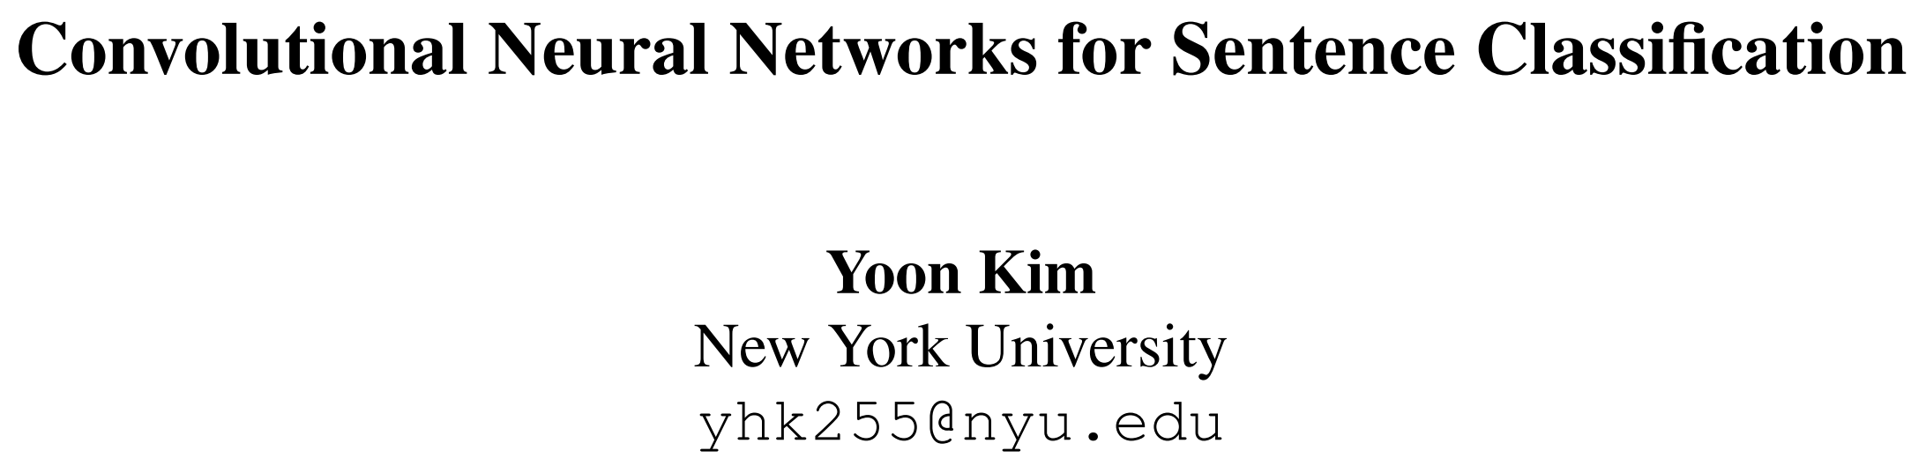
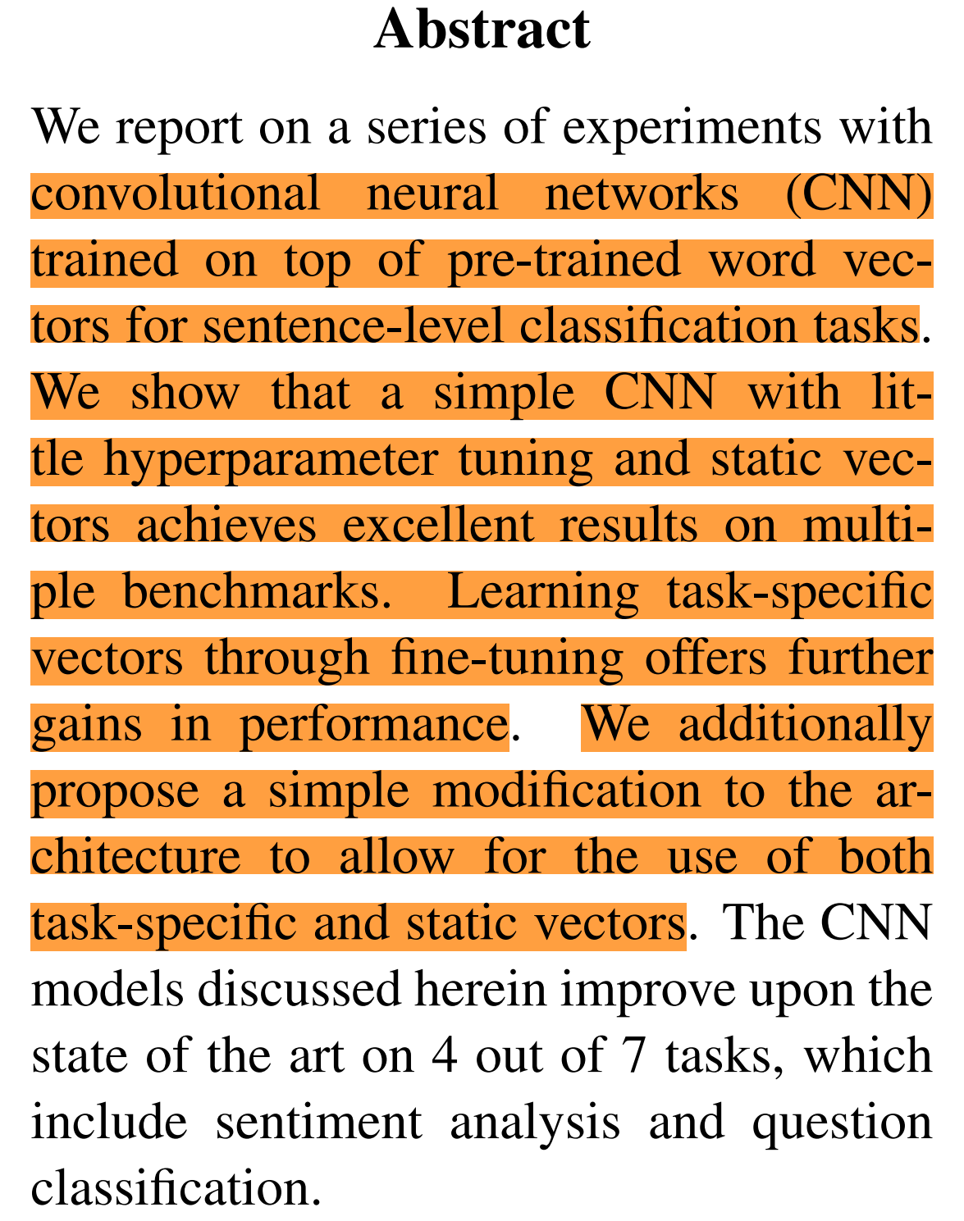
Abstract
pre-trained word vector와 간단한 convolution neural network를 이용하여, 다양한 sentence-level classification에서 좋은 성능을 보여줌
Notes:
Memory footprint가 작으면 main memory에 access할 일이 없기때문에, cache memory를 사용할 수 있어 그만큼 빠르다!

Slide 4
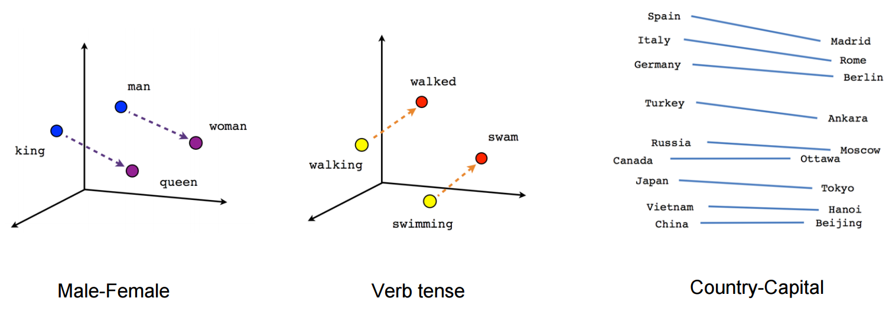
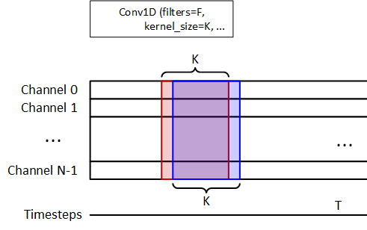
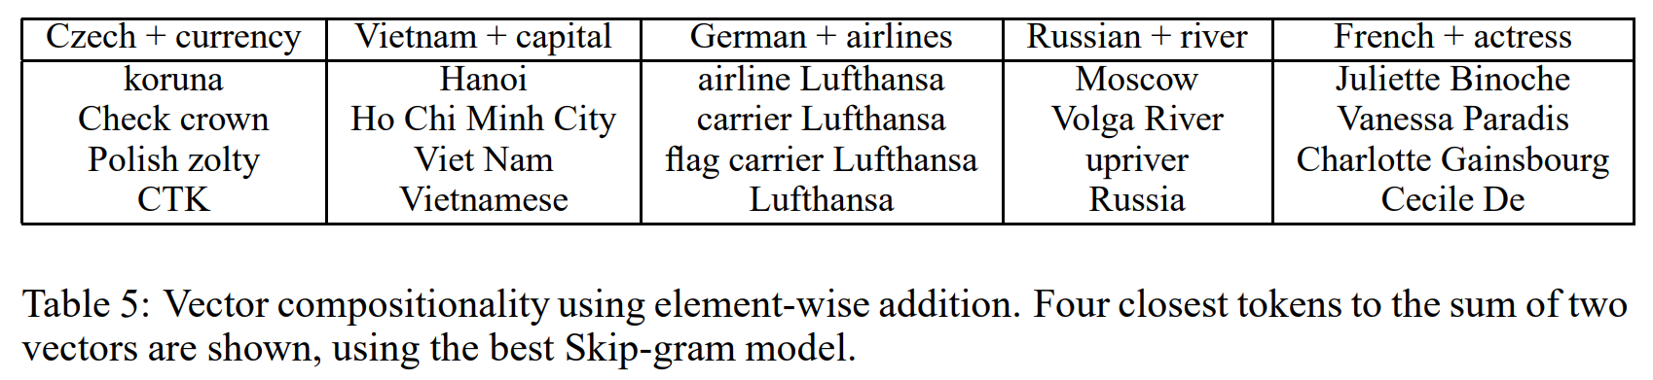
Introduction
semantic 잘 encoding하는 word vector를 universal feature extractor로 활용하고, 이를 convolution neural network로 학습하는 강건한 model을 제안
word vector
1d convolution
https://www.tensorflow.org/tutorials/representation/word2vec
Distributed Representations of Words and Phrases and their Compositionality (https://arxiv.org/pdf/1310.4546.pdf)
https://medium.com/@jon.froiland/convolutional-neural-networks-for-sequence-processing-part-1-420dd9b500

Slide 5
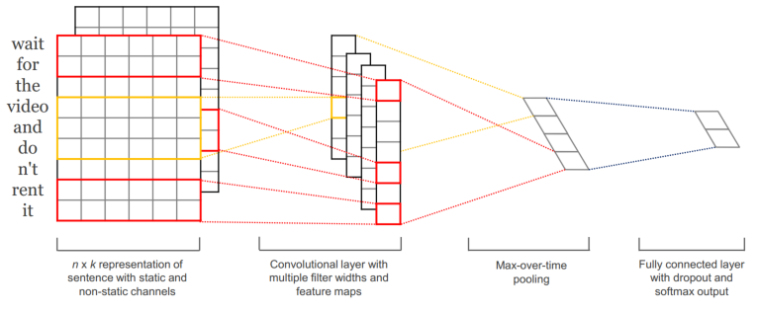



Model : CNN-multichannel
pre-trained word vector를 이용, training 유무에 따라 static channel, non-static channel로 representation하고, 이를 input으로 model을 학습
Input (sentence length : n)
$$x_{1:n}=x_{1}⊕x_{2}⊕…⊕x_{n},x_{1:n}∈ℝ^{nk}, x_{i}∈ℝ^{k}$$
Convolution layer (filter width : h)
convolution operation (each filter)
$$w_{conv}∈ℝ^{hk}, b_{conv}∈ℝ$$
$c_{i}^{static}=f\left(w_{conv}∙x_{i:i+h−1}^{static}+b_{conv}\right)$
$c_{i}^{non−static}=f\left(w_{conv}∙x_{i:i+h−1}^{non−static}+b_{conv}\right)$
$c_{i}=c_{i}^{static}+c_{i}^{non−static}$
$c=\left[c_{1},c_{2},…,c_{n−h+1}\right], c∈ℝ^{n−h+1}, c∈ℝ$
max-overtime-pooling operation (each feature map)
$\hat{c}=\max\left\{c\right\}, \hat{c}∈ℝ$
Fully connected layer (before using m filters, k classes)
$$\dim\left(w_{dense}\right)=\left(k, m\right),b_{dense}∈ℝ^{m}, r∈ℝ^{m}$$
r : masking vector of Bernoulli random variables with probability $p$ of being 1 (drop out)
$z=\left[{\hat{c}}_{1}, {\hat{c}}_{2}, …, {\hat{c}}_{m}\right], z∈ℝ^{m}$
$y=w_{dense}\left(z∘r\right)+b_{dense}, w_{dense}=\left[\begin{matrix}w_{1}^{T} \\ ⋮ \\ w_{k}^{T}\end{matrix}\right]$
$prob=softmax\left(y\right), prob∈ℝ^{m}$
Train and Test
At train time, we additionally constrain $l_{2}−norms$ of the weight vectors by rescaling $w_{dense}$ to have ${\left\|w_{dense}\right\|}_{2}=s$ whenever ${\left\|w_{dense}\right\|}_{2}>s$ after a gradient descent step. At test time (without drop out),
${\hat{w}}_{dense}=pw_{dense}$ (scaled by p)

Slide 6
Model : Variation
CNN-multichannel model 말고도, 실험을 위해 아래와 같은 variation들을 학습하고 비교함
CNN-rand
single channel
모든 word vector에 대해서 random initialization
word vector가 training에 포함됨
CNN-static
Single channel
기본적으로 pre-trained word vector로 initialization을 하고, pre-trained word vector set에 없는 word의 경우 random initialization
word vector가 training에 포함되지않음
CNN-non-static
single channel
기본적으로 pre-trained word vector로 initialization을 하고, pre-trained word vector set에 없는 word의 경우 random initialization
word vector가 training에 포함됨
CNN-multichannel
double channel (static channel, non-static channel)
word vector를 initialization하는 방법을 동일하게 각 channel에 적용
non-static channel이 training에 포함됨

Slide 7
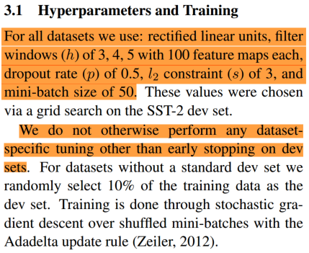
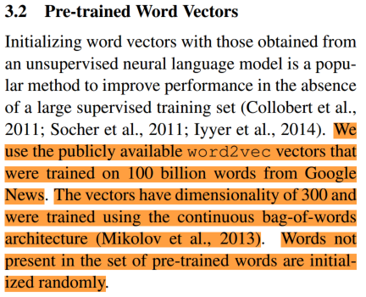
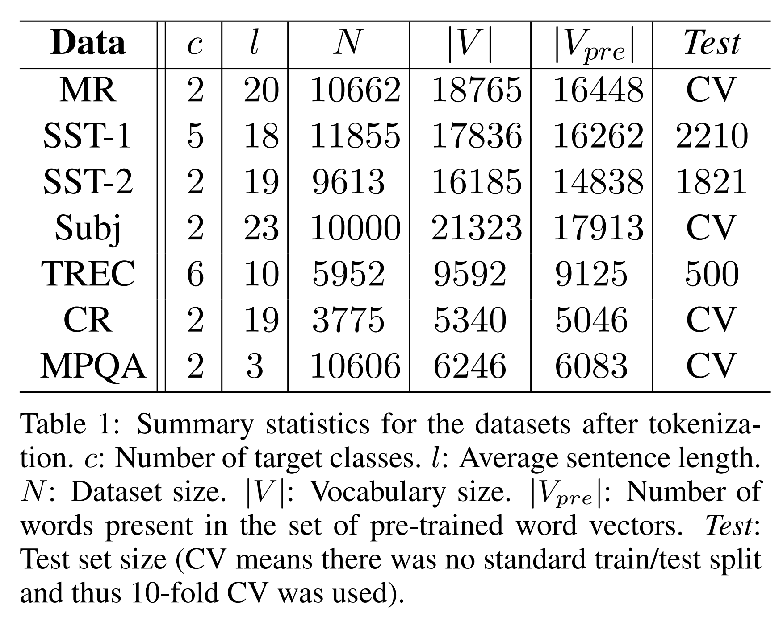
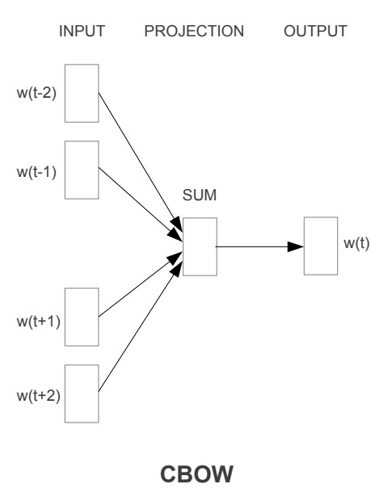
Datasets and Experimental Setup
다양한 데이터셋에 같은 구조를 지닌 모형으로 실험하고, pre-trained word vector로는 continuous bag of words 방식으로 학습된 word vector 활용
Efficient Estimation of Word Representations in Vector Space (https://arxiv.org/pdf/1301.3781.pdf)

Slide 8
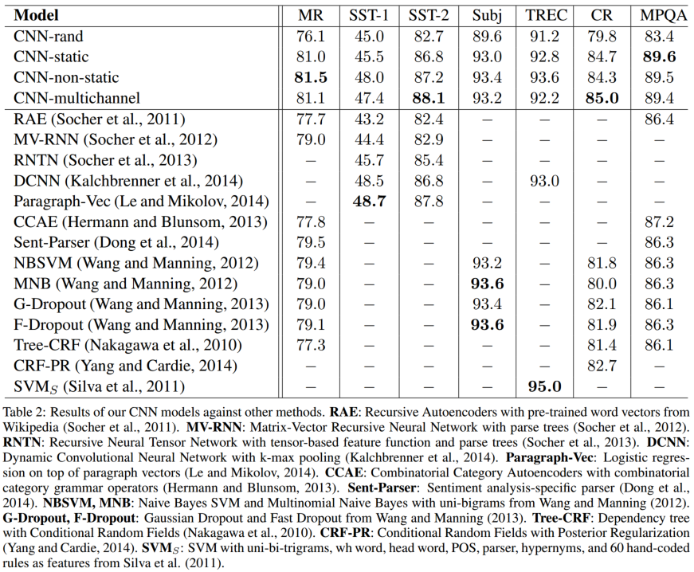
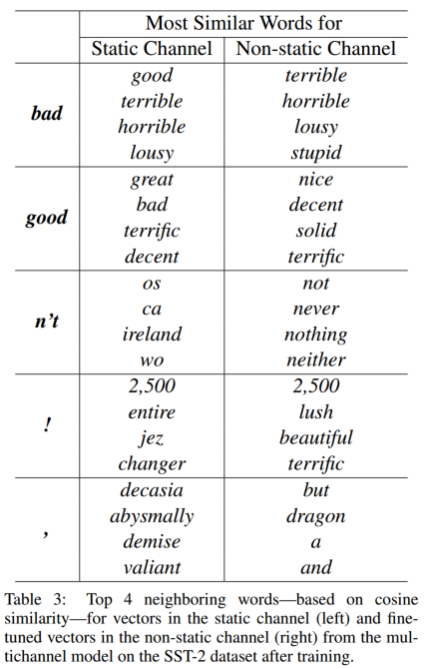
Results and Discussion (1/2)
pre-trained word vector를 사용만해도 성능이 증가, fine-tuning하는 경우에는 word vector가 task-specific하게 semantic을 잘 encoding함
Sentiment analysis dataset

Slide 9
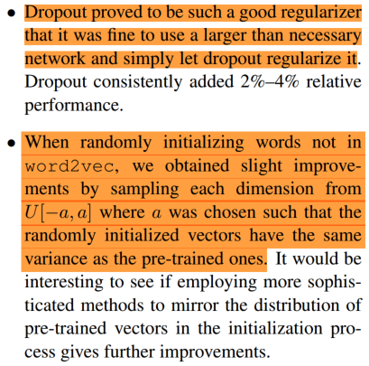
Results and Discussion (2/2)
pre-trained word vector가 존재하지 않는 word의 경우, pre-trained word vector의 각 dimension의 variance를 반영하여 initialization 하는 것이 좋음

Slide 10
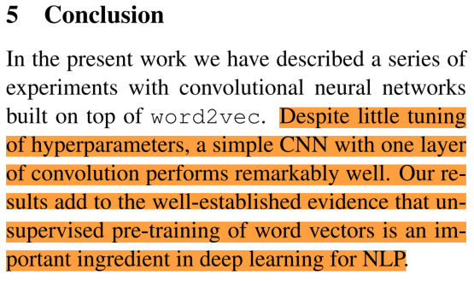
Conclusion

Slide 11

Q & A

Slide 12
감사합니다.

